Slide 1
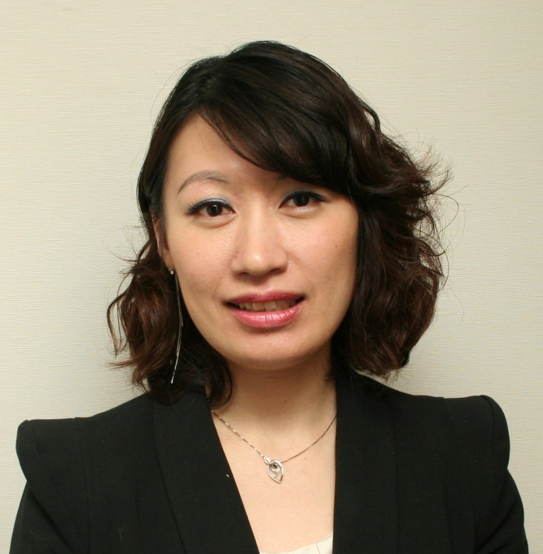
新產品巡禮
New Product Spotlights
Emmy Yeung
產品拓展經理
Product Manager

Slide 2




Slide 3
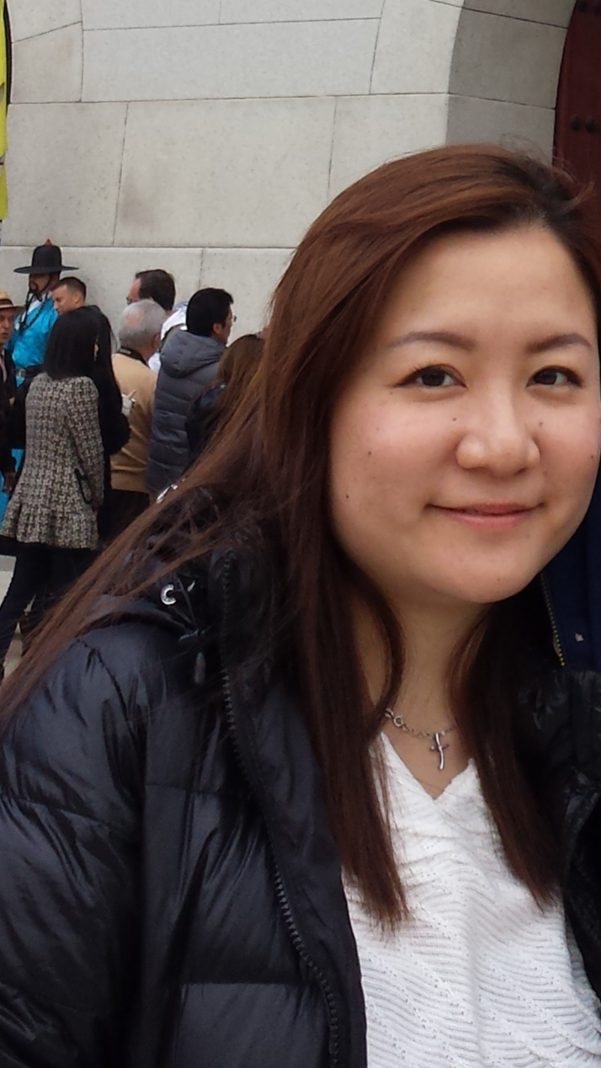

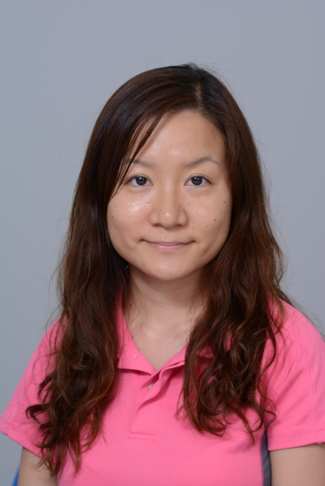

NATALIE KO
BEFORE
AFTER

Slide 4
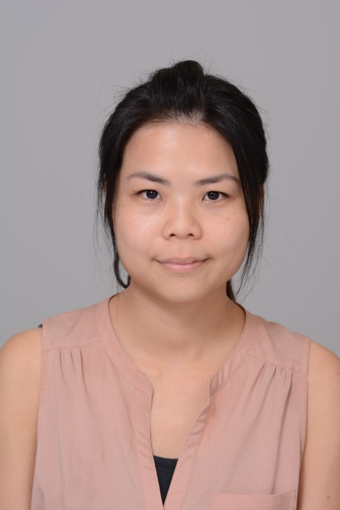
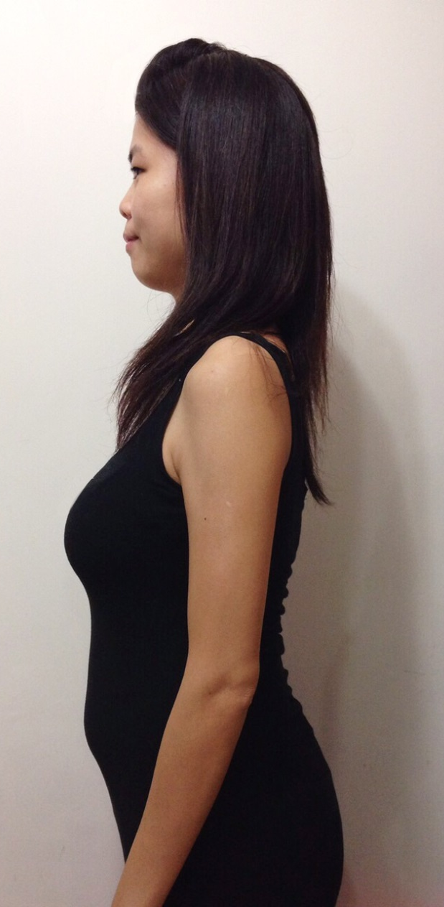
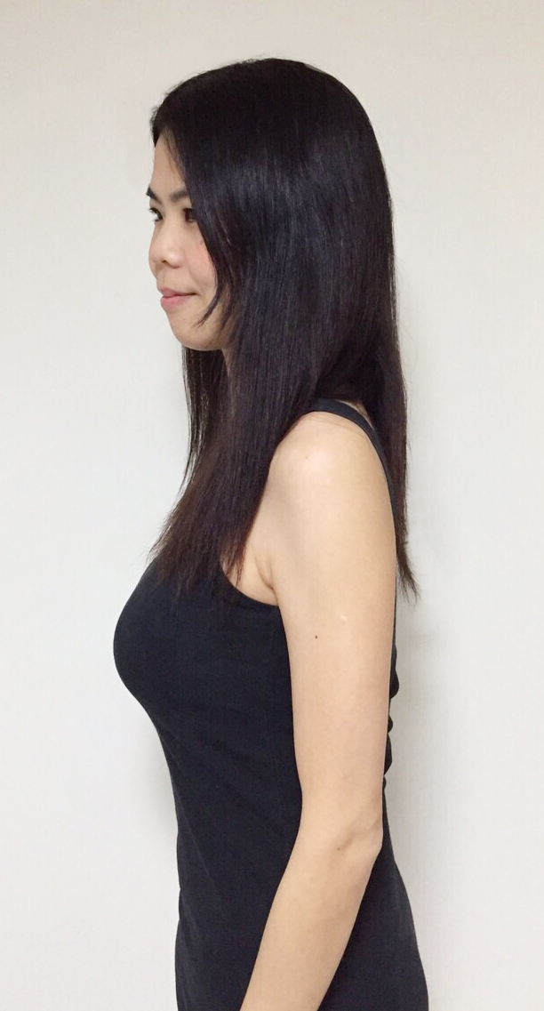
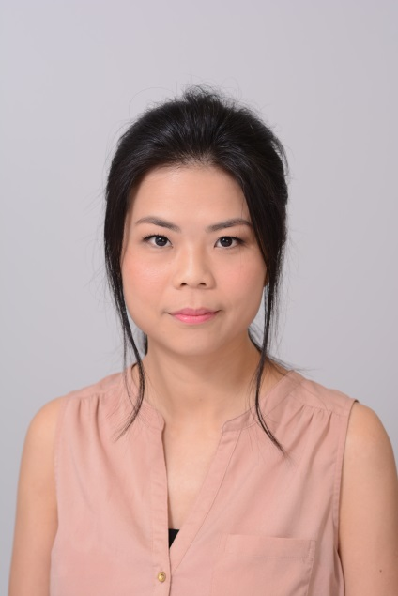
BEFORE
AFTER
JESSICA CHEUK

Slide 5
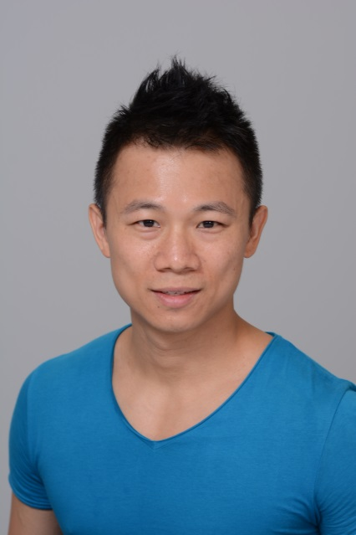

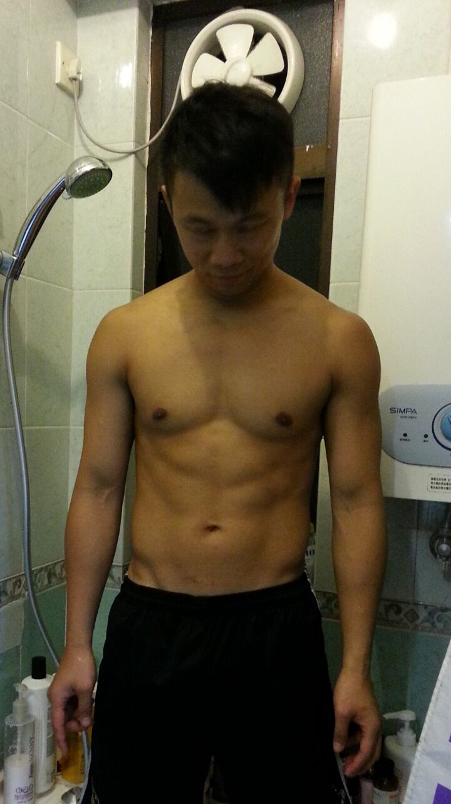
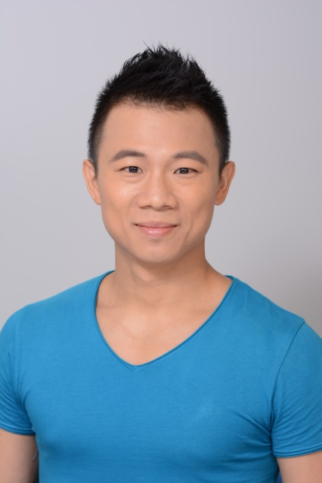
PATRICK
BEFORE
AFTER

Slide 6
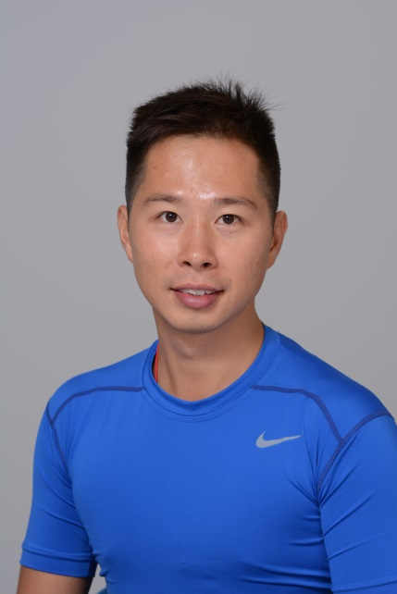
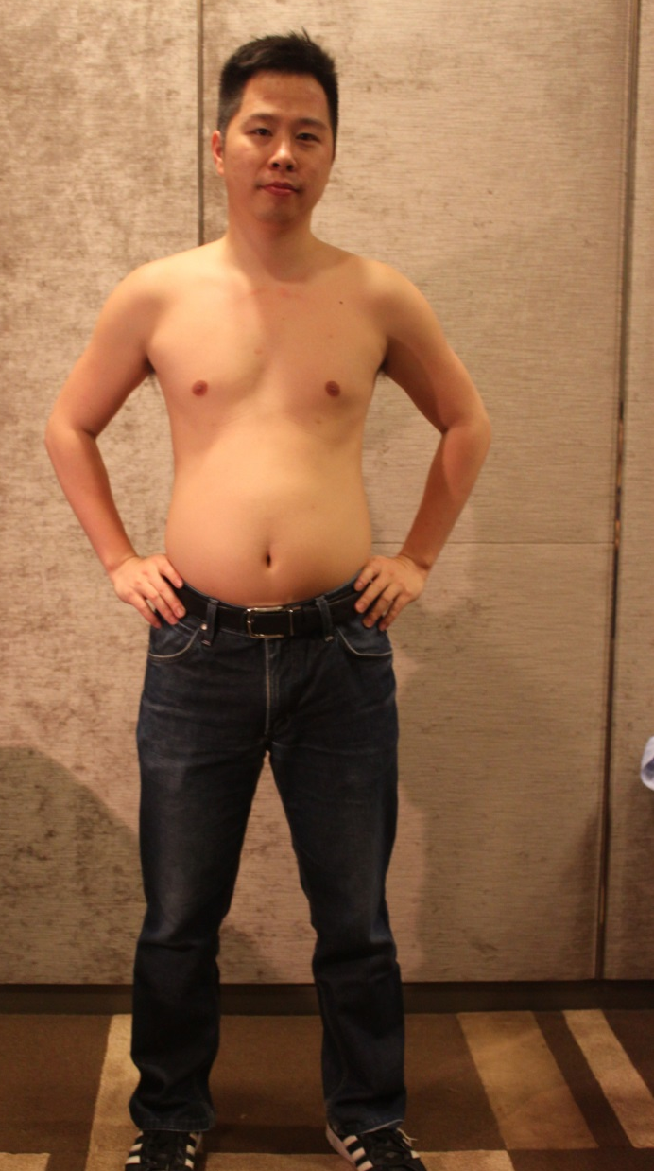
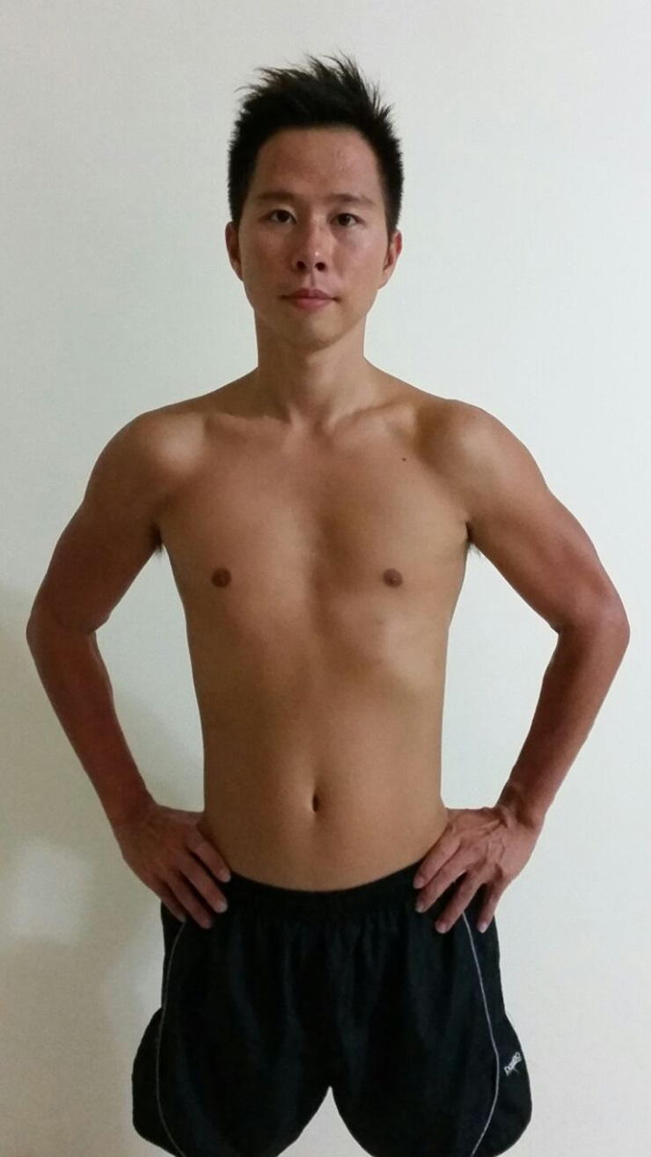
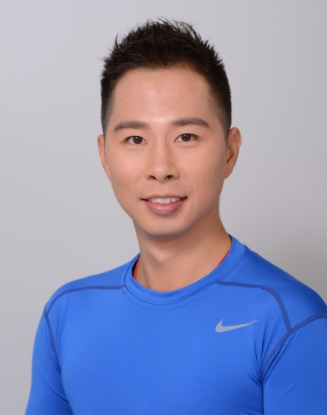
KC
BEFORE
AFTER

Slide 7
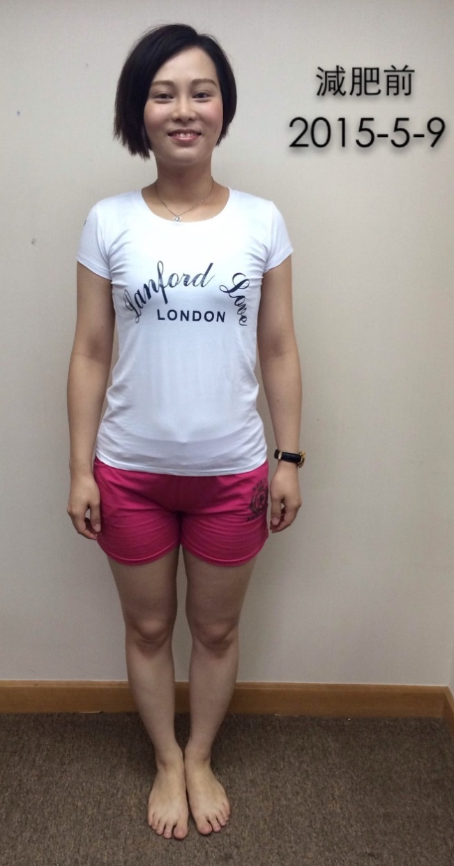
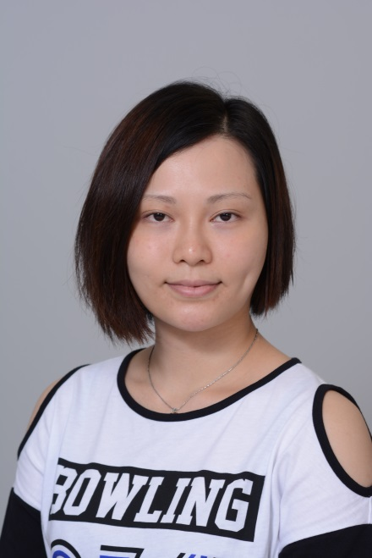
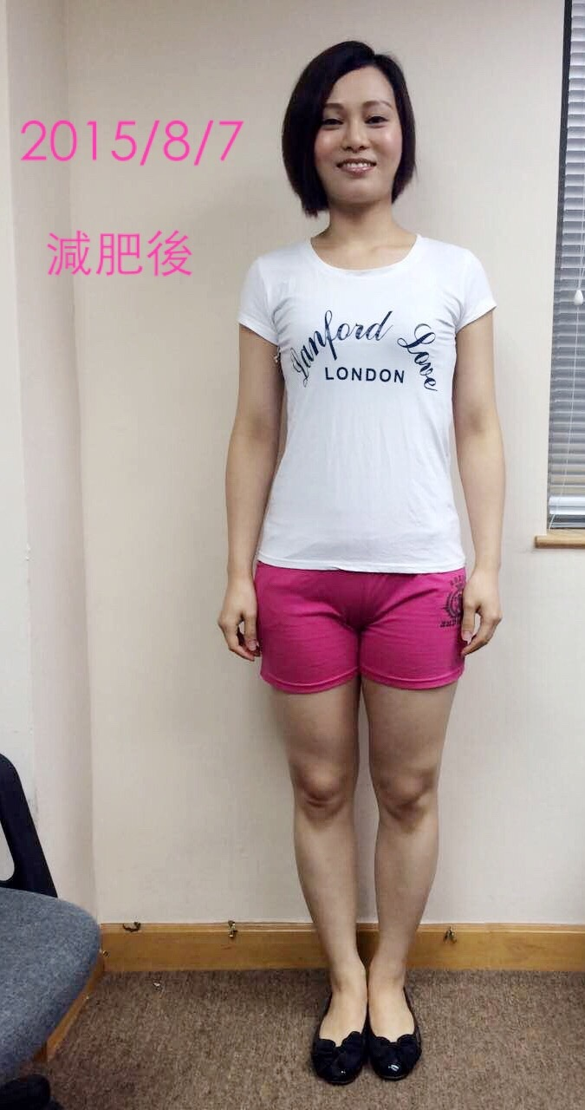
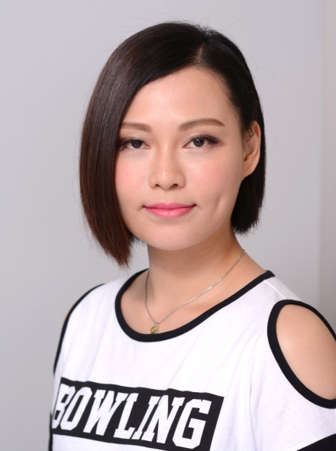
BEFORE
AFTER
KITTY

Slide 8
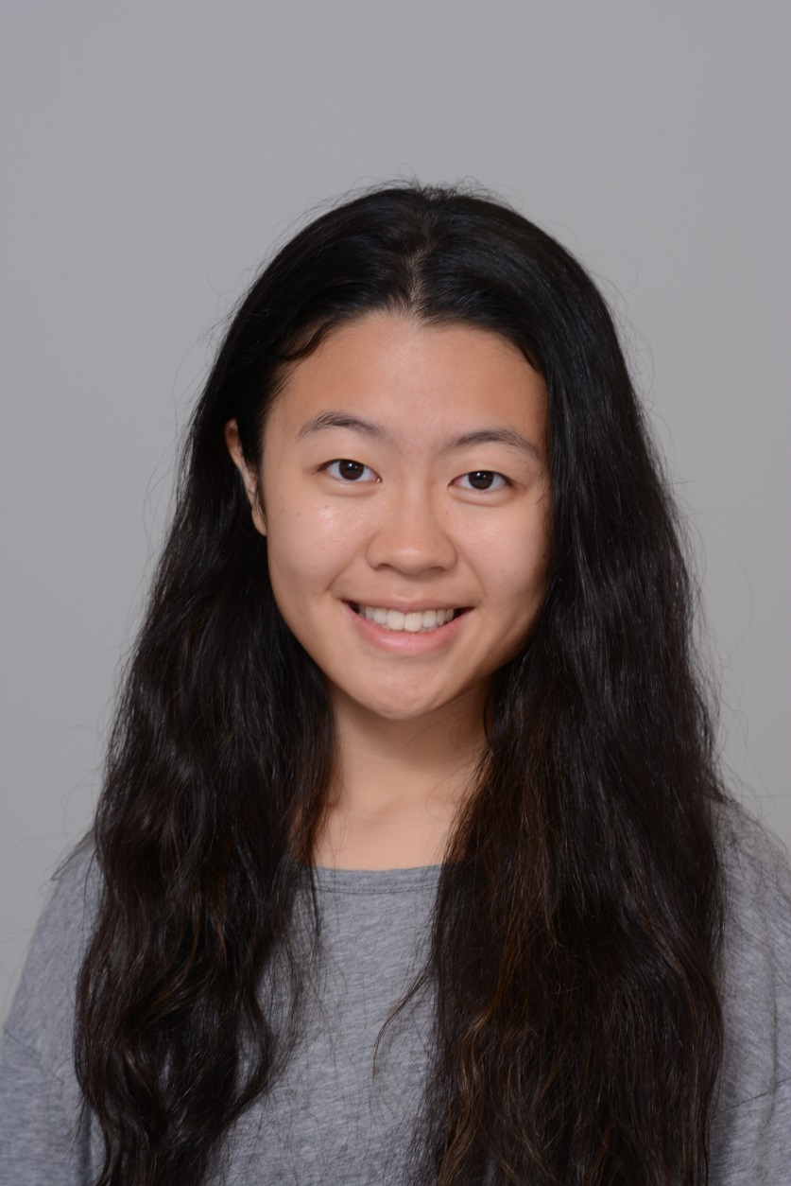
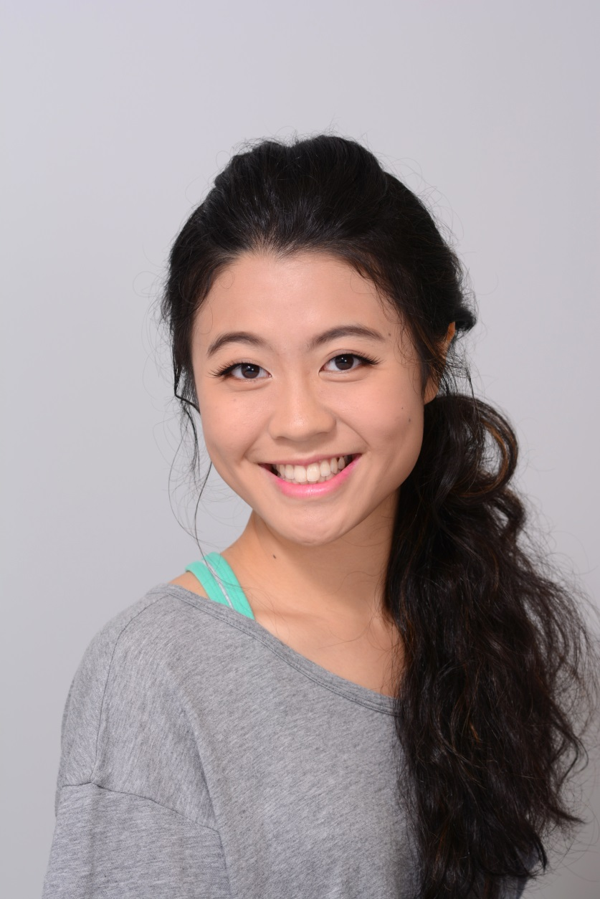
BEFORE
AFTER
MICHELLE LAM

Slide 9



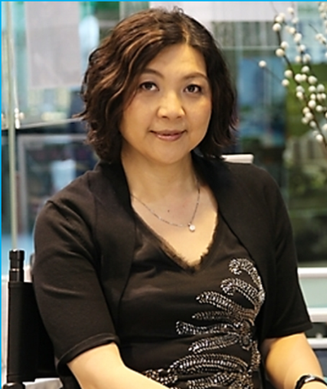

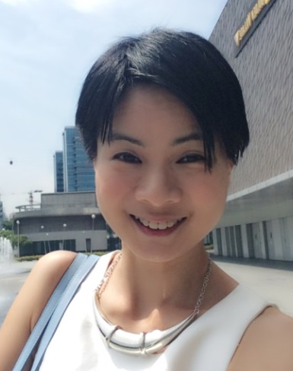
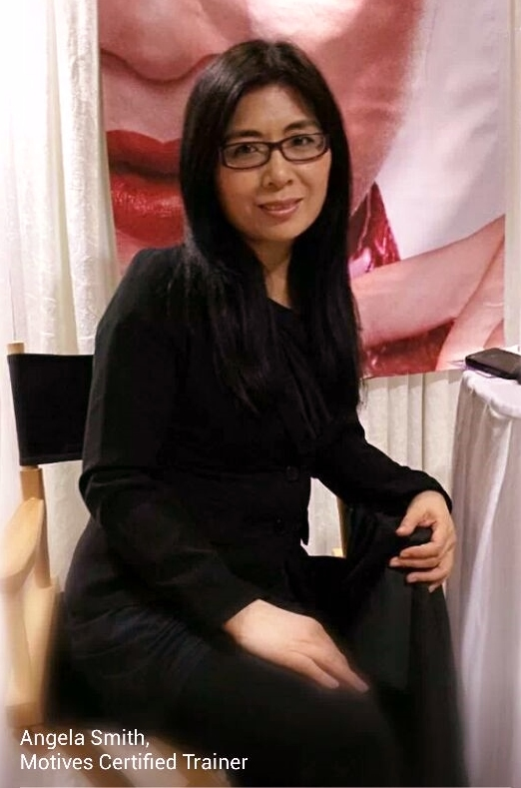
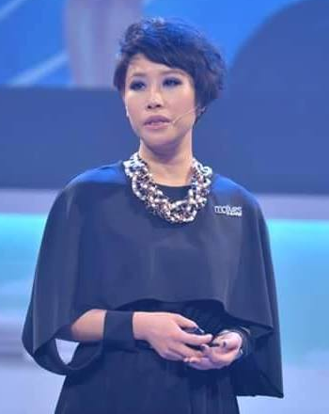

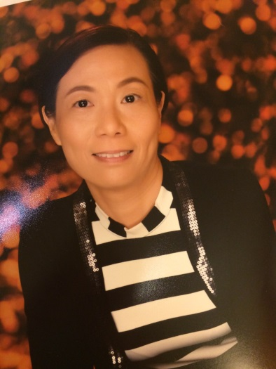

Motives®授證訓練員 Certified Trainers
Helen Lin
Mony Ung
Rose Wong
Reginia Wong
Kero Chan
Tammy Lui
Angela Smith
Angie Chou
Claudia Chow
May Ho
Asa Ng

Slide 11
2014 vs. 2015首六個月的產品業績增長
Product Sales Growth in the First Six Month
產品總銷售增長
Total product sales growth
↑16.3%

Slide 12




新產品巡禮 New Product Spotlights

Slide 13
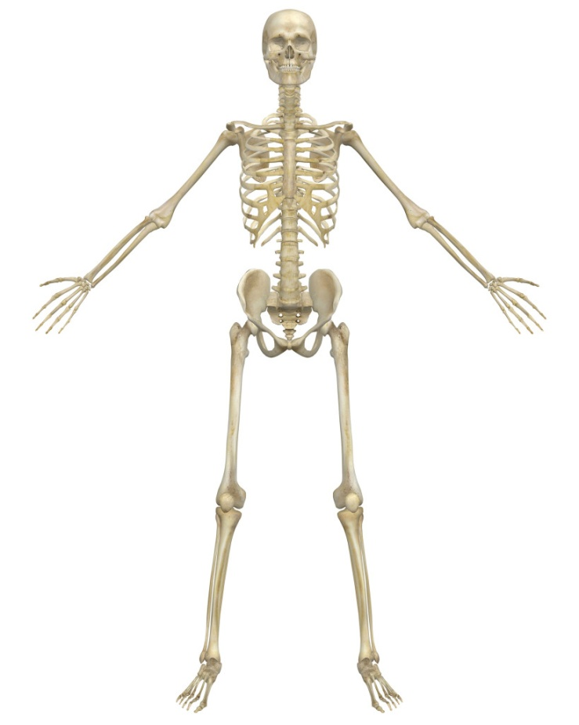
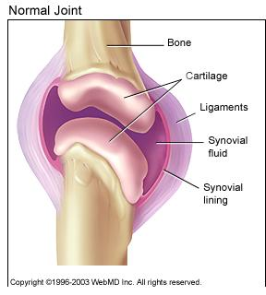
骨骼與關節 Bone & Joint
200+
骨頭和關節
Bones & Joints
關節是兩塊骨頭之間的連接。
A joint is the connection between two bones.

Slide 14

《香港在職人士關節健康調查》
Joint Health Survey for Working Force
訪問年齡介乎35-50歲的本港在職人士
506個成功個案，當中男、女各佔一半
Survey group: 35 – 50 years of age
506 cases, with 50% male and 50% female
Notes:
https://www.hkupop.hku.hk/chinese/archive/report/jcare04/freq.html

Slide 15
過去十二個月內，你有冇試過係關節上，出現以下症狀？
In the past 12 months, did you experience the following discomfort in your joint?
 | 百分比 Percentage
痠痛 Pain | 71.7
痺痛 Paralyze | 37.4
無力 Lack of energy | 22.9
活動不靈 Inactive in Movement | 18.0
僵硬 Stiffness | 13.6
發熱 Burning | 12.1
紅腫 Redness | 8.5
完全冇上述症狀 None of the above | 20.9

Slide 16
當感到關節不適時，你認為是甚麼原因？
What are the causes?
 | 百分比 Percentage
工作上影響 Work influence | 35.8
年紀大 Aging | 8.5
軟骨退化 Aging of cartilage | 4.9
運動受傷／過度 Exercise | 4.9
姿勢不正確 Incorrect posture | 3.8
運動不足 Lack of exercise | 3.8
壓力大 Stress | 8.5
體重問題 Overweight | 1.2

Slide 17
當感到關節不適時，你會如何處理？
How would you handle the pain?
 | 百分比 Percentage
搽藥酒／藥膏 Ointment | 33.2
醫生／物理治療師 Doctors/Therapies | 21.5
做運動及舒緩活動 Exercise/Stretching | 15.8
按摩 Massage | 10.1
購買止痛藥或其他藥品服用 Medicine | 4.7
購買健康保健品 Supplement | 0.8
不理會 Not taking any actions | 7.5

Slide 18
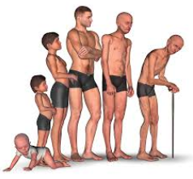
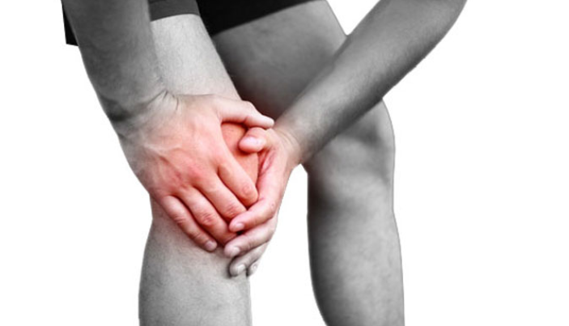
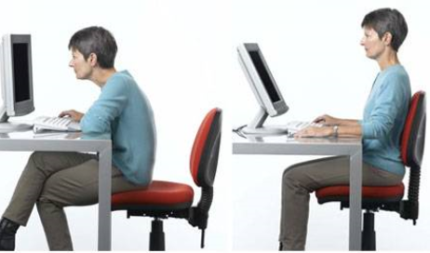
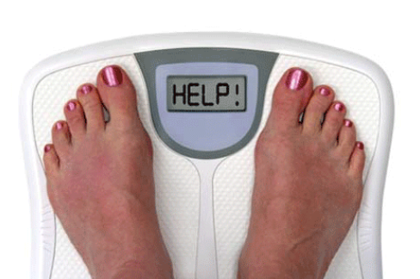
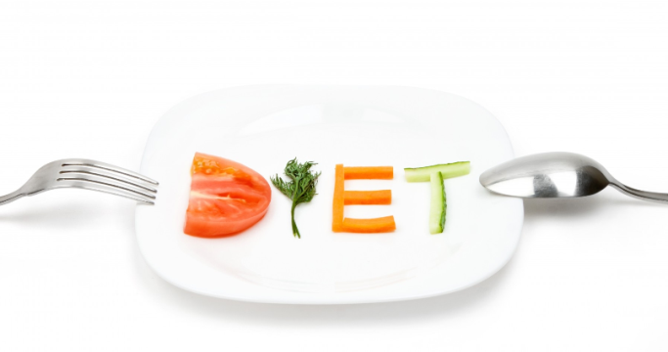

關節健康 Joint Health
Notes:
http://www.webmd.com/arthritis/caring-your-joints

Slide 19
關節健康有效成份 Joint Health Proven Ingredients
葡萄糖胺
  關節液和軟骨內重要的組成部份
玻尿酸
  隨年齡增長而自然流失﹔潤滑和補充組織水份﹔抑制酵素分解軟骨
碧容健®
  減少炎症反應﹔促進和支持關節靈活性、柔韌性和舒適性
Glucosamine
  Important component within synovial fluid and cartilage
Hyaluronic Acid
  Naturally diminishes with ages; tissue hydration and lubrication; inhibits enzymes that breakdown cartilage
Pycnogenol®
  Inflammatory response; demonstrated ability to promote and support joint mobility, flexibility and comfort

Slide 20
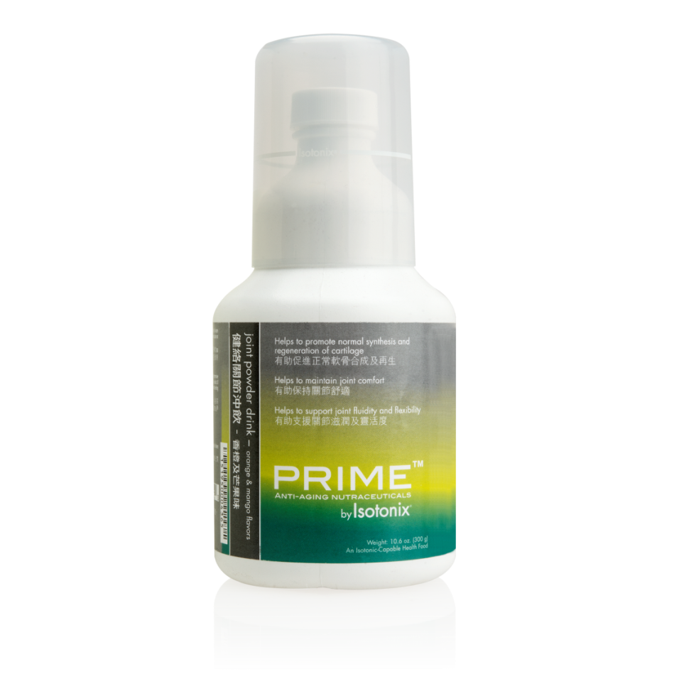
Isotonix®健絡關節沖飲
Prime Joint Support by Isotonix
有助促進軟骨正常合成和再生
有助維持關節舒適感
有助支援關節順滑度和靈活性
支援整體關節健康
NEW
Helps to promote normal synthesis and regeneration of cartilage
Helps to maintain joint comfort
Helps to support joint fluidity and flexibility
Supports overall joint health

Slide 21
Isotonix®健絡關節沖飲
Prime Joint Support by Isotonix
市場上唯一提供等壓吸收：
葡萄糖胺
碧容健®
玻尿酸
Only product delivering the ingredients in Isotonic form:
Glucosamine
Pycnogenol
Hyaluronic Acid

Slide 22

Isotonix®健絡關節沖飲
Prime Joint Support by Isotonix
Code: HK13081
UC: $461.00 | SR: $645.00
BV: 42
即將登場
COMING SOON

Slide 23
Isotonix®健絡關節沖飲的市場比較
Prime Joint Support by Isotonix vs. Competitors
產品 Product | Isotonix® | 葡萄糖胺 Glucosamine | 碧容健® Pycnogenol | 份量／價格Serving/Price
Prime Joint Support by Isotonix | √ | 1,000mg | √ | 45 / $645.00
GNC Glucosmine 750 | X | 750mg | X | 30 / $468.00
Blackmores | X | 750mg | X | 60 / $349.90

Slide 24
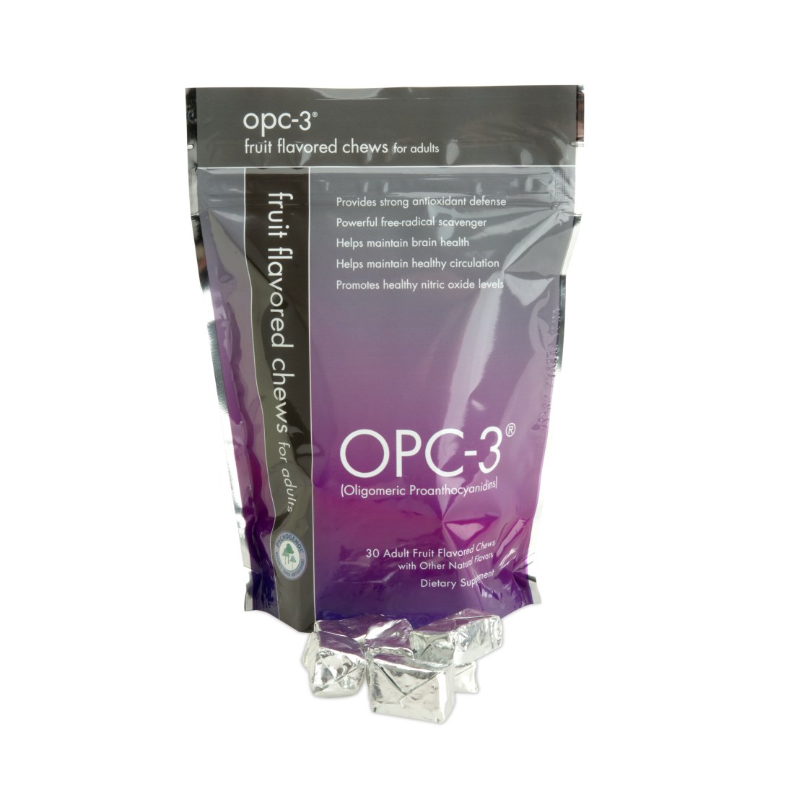
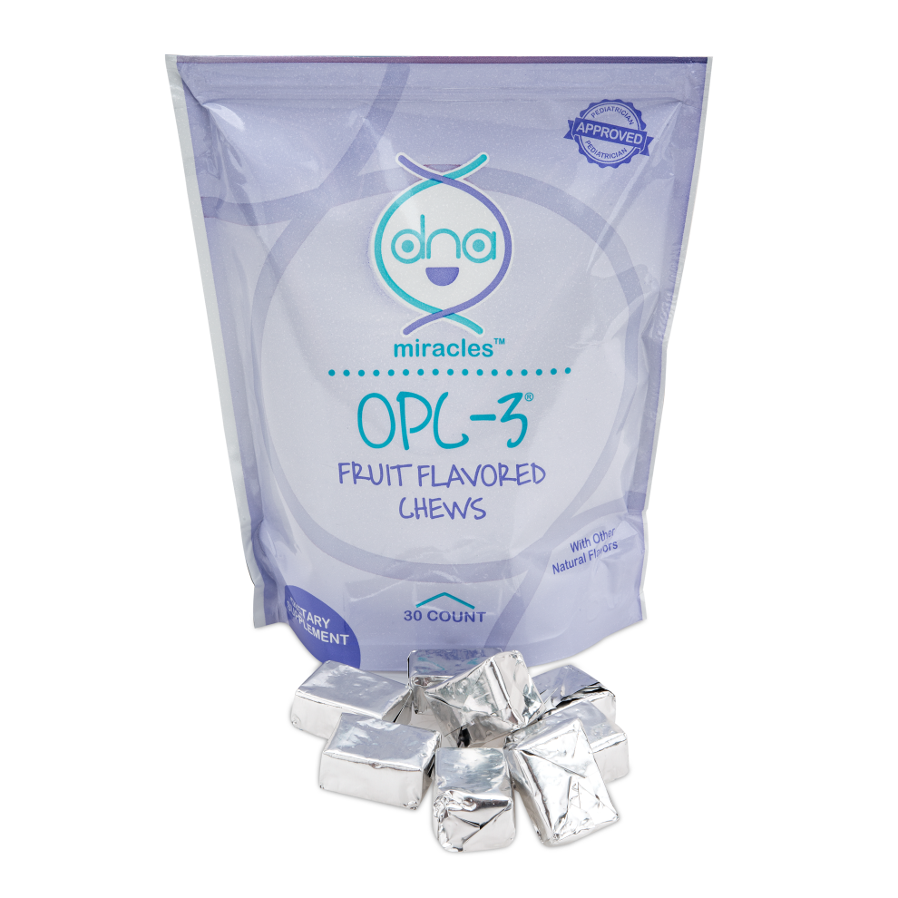
OPC-3®軟糖
OPC-3® Chews
一粒軟糖令你盡享OPC–3®的好處
Enjoy all the benefits that OPC-3® has to offer in fruit flavored chews

Slide 25
OPC-3®軟糖
OPC-3® Chews
一粒軟糖令你盡享OPC–3®的好處
Enjoy all the benefits that OPC-3® has to offer in fruit flavored chews
支援健康膚色
支援健康血管功能及血液流動
提供抗氧化防護
Supports a healthy complexion
Supports healthy blood vessel function and blood flow
Provides antioxidant defense

Slide 26
OPC-3®軟糖
OPC-3® Chews
主要成份（各25毫克）：
碧容健®
葡萄籽萃取物
歐洲藍莓萃取物
柑橘生物類黃酮萃取物
紅酒萃取物
Primary ingredients (25mg each):
Pycnogenol®
Grape Seed Extract
Bilberry Extract
Citrus Bioflavonoids Extract
Red Wine Extract

Slide 27
OPC-3®軟糖
OPC-3® Chews
HK6903
UC: $188.00
SR: $263.00
BV: 15.00
現已發售
AVAILABLE NOW

Slide 28

極緻研亮護膚系列

Slide 29

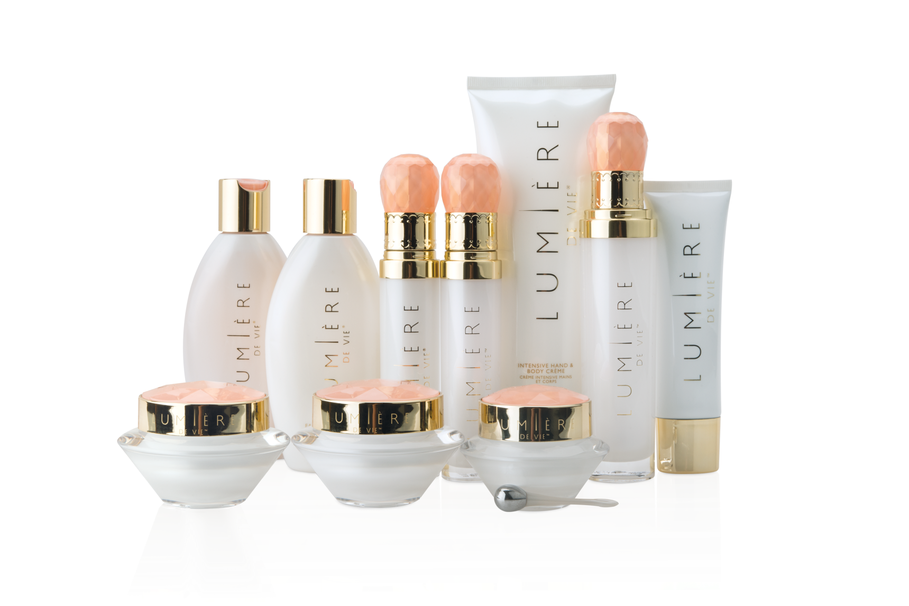
極緻妍亮尊貴組合
Full Regimen Kit
25%
Code: HK12209
UC: $2,422.00 | SR: $3,410.00 | BV: 200

Slide 30

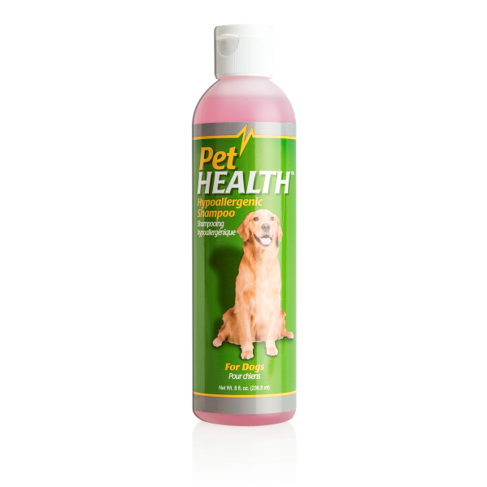
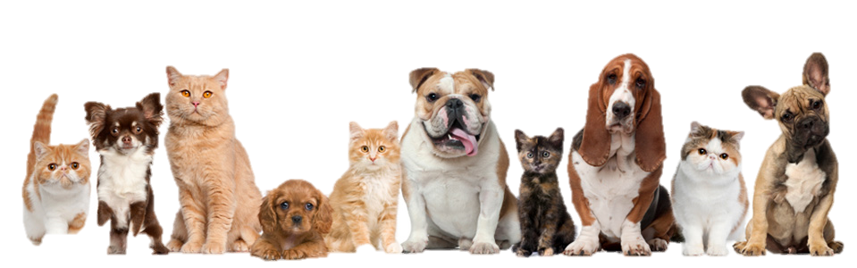
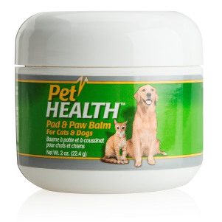
愛錫你的寵物健康
Healthy pets, happy owners

Slide 31
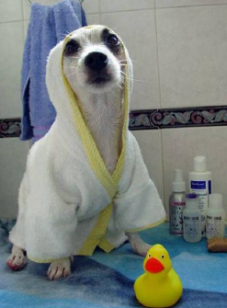
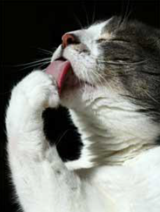
PetHealth™
狗是特別容易越受到環境刺激和污染，導致皮毛暗淡，乾燥
市面上許多清潔劑會刺激牠們的皮膚， 影響脂質屏障
Dogs are increasingly subject to environmental irritants and pollution resulting in a dingy, dry coat
Many soaps and detergents contribute to irritation and can strip the skin of its natural lipid barrier

Slide 32
PetHealth™防敏寵物沐浴露
Hypoallergenic Shampoo
潔淨寵物毛髮，令毛色更加亮麗
滋潤和調理寵物毛髮
不刺激、不刺眼配方
平衡pH值
適合中性、乾性或敏感皮膚使用
不含酒精
不含防腐劑
不含苯甲酸酯
Cleanses and polishes coat
Moisturizes and conditions
Non-irritating, non-stinging, even in the eyes
pH balanced
For normal, dry and sensitive skin
Alcohol-Free
Preservative-Free
Paraben-Free

Slide 33
PetHealth™寵物腳掌軟膏Pad & Paw Balm
有助護理輕微皮膚刺激
促進自然修復過程
有助維持皮膚彈性
潔淨和滋潤皮膚
含有必要脂質，保護由脂質組成的皮膚屏障
不含酒精
不含防腐劑
Helps in the care of minor skin irritations
Promotes natural healing properties
Helps maintain skin elasticity
Cleanses and moisturizes
Contains essential lipids to protect skin’s lipid barrier
Alcohol-Free
Preservative-Free

Slide 34
COMING SOON
即將登場
Code: HK5618
UC: $90.00 | SR: $125.00
BV: 10
HK5612
UC: $103.00 | SR: $144.00 103.00 | BV: 10

Slide 36

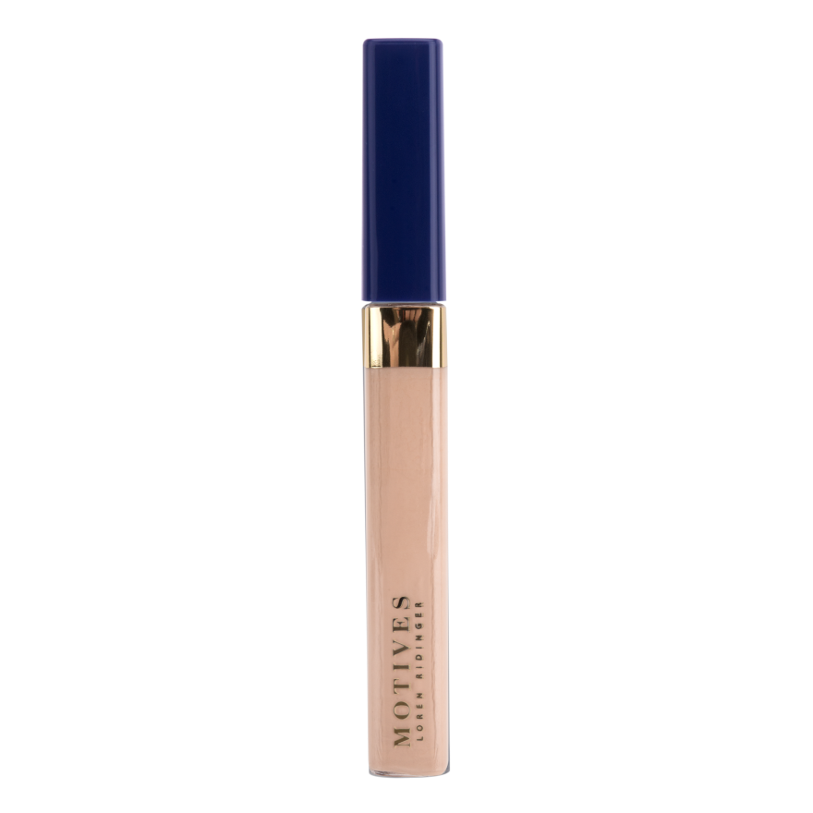
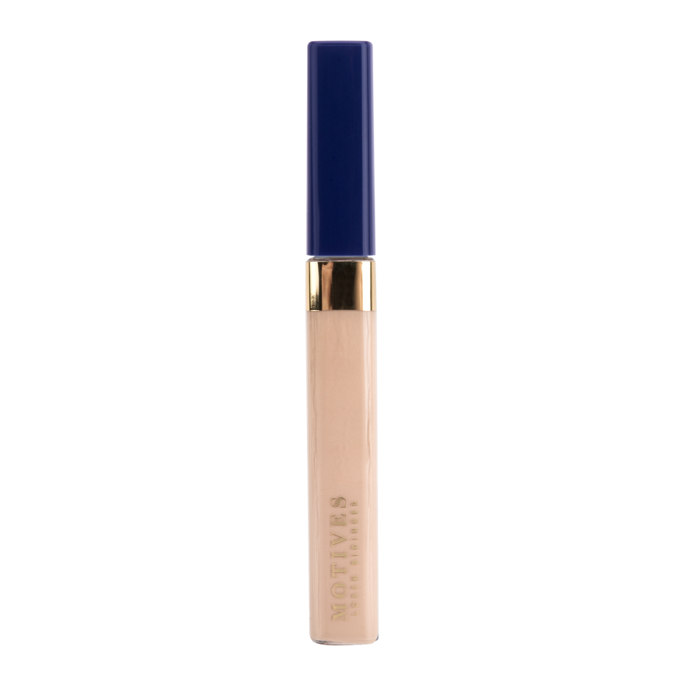
MOTIVES長效遮瑕液
Long Wear Liquid Concealer
Light (Pink Undertone)
HK005MLCC
Light (Yellow Undertone)
HK006MLCC
UC: $120.00 | SR: $168.00 | BV: 10.5

Slide 37
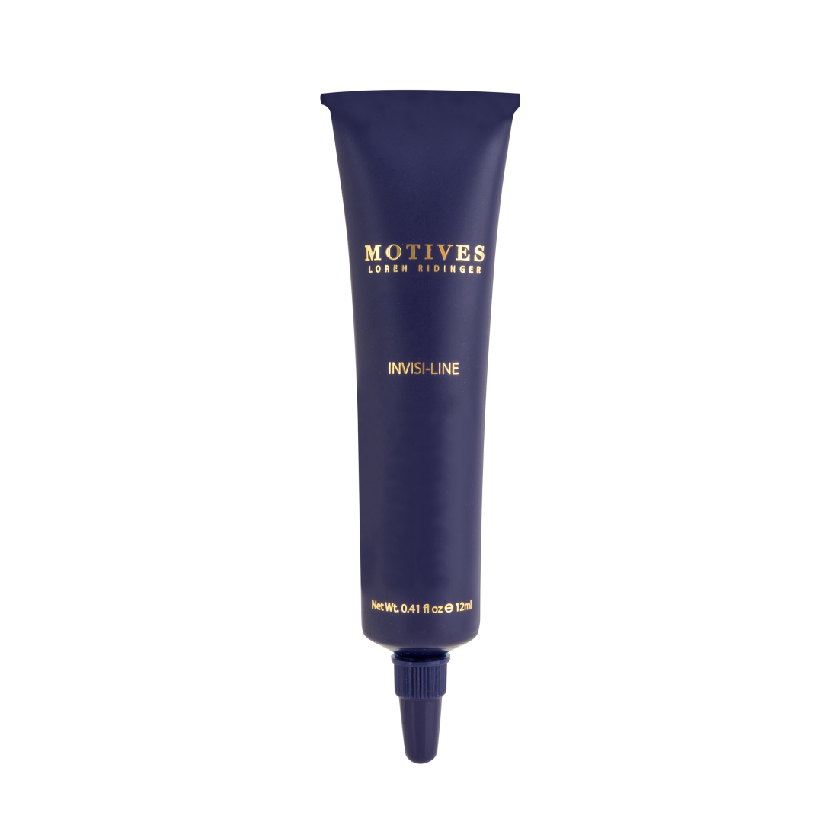
Motives瞬間無痕妝前底霜
Invisi-line
HK200LEG
UC: $112.00 | SR: $158.00
BV: 10.0

Slide 38
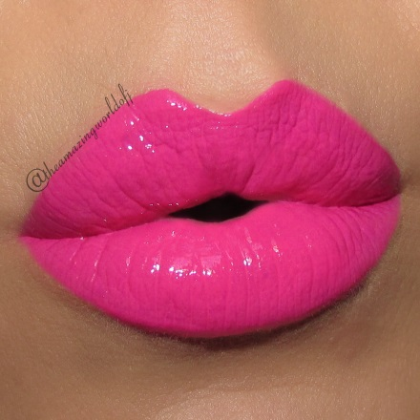
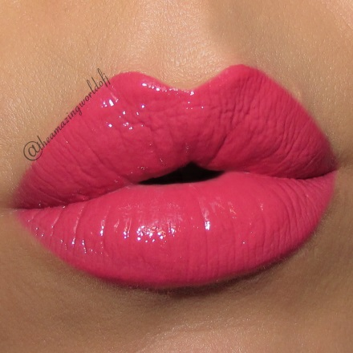
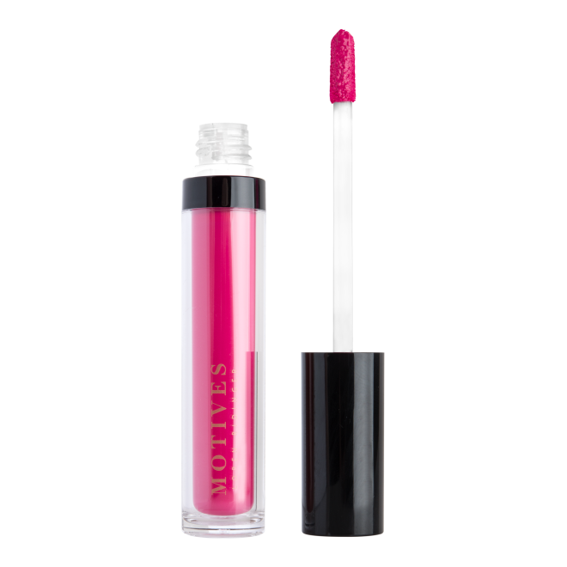
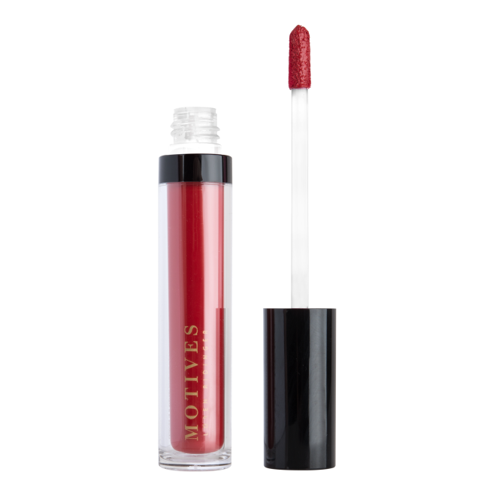
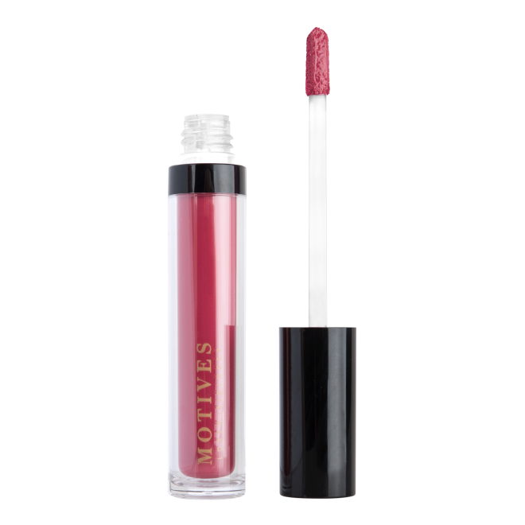
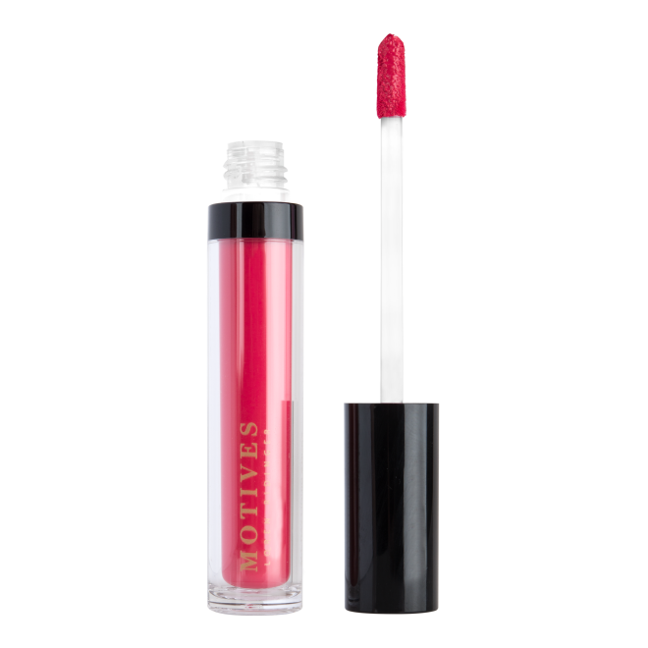
MOTIVES持久水潤唇蜜
All Day Liquid Stick
UC: $143.00 | SR: $200.00 | BV: 12.0

Slide 39




Motives閃粉眼妝底霜
Glitter Adhesive
HK100MGF
UC: $96.00 | SR: $135.00 | BV: 8.0

Slide 40








TENI
PANOSIAN
@tenipanosian
JACKIE
GOMEZ
@jgmakeupxoxo
DENISE
SANCHEZ
@makeupbydenise
MARYAM MAQUILLAGE
@maryamnyc
ELIZABETH
MARINO
@elymarino
ELLARIE
NOEL
@ellarie
AURORA GONZALEZ BRAVO
@auroramakeup

Slide 41




UC: $235.00 | SR: $330.00 | BV: 18.0

Slide 42



工具 Tools

